Slide 1

Lesson 4.1: Intro to Lists
Microsoft Philanthropies TEALS Program
Introduction to Computer Science

Slide 2
Intro to Lists
After this lesson, you will be able to...
Explain the concept of a “list” in a programming context
Identify scenarios in which lists are useful

Slide 3
Today’s Plan
Do Now
Introductory Discussion
Debrief
Translate algorithms into SNAP pseudocode
Debrief and wrap-up
Notes:
Duration Description
5 minutes | Do Now
10 minutes | Introductory discussion
10 minutes | Debrief
10 minutes | Translate algorithms into SNAP pseudocode
10 minutes | Debrief and wrap-up

Slide 4

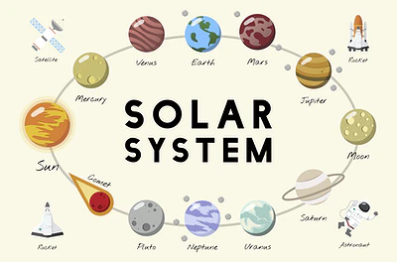
Introductory Discussion
How could we collect and store information and discoveries in a computer program?
Notes:
Shortly describe the Solar System - Sun, planets, etc, and hook your students in with a way (in programming) to collect and store new information and discoveries.

Slide 5

Activity Discussion
In your group,
Write an algorithm for adding new Solar System discoveries to a collection of older ones.
Include the steps to be taken and the necessary materials and resources.
The algorithm should work for any discovery of any name, size and does not make assumptions
Notes:
Split the class up into small groups of 2-3 students.
As with the PB&J activity, the process should be complete and detailed so that a person can unambiguously follow the steps.

Slide 6
Activity – Part 1
As a group, write pseudocode to attempt to solve the problem.

Slide 7
Activity - Part 2
Now, scientists organize their discoveries alphabetically not by recently discovered.
Challenge them to create an algorithm that organizes their new discoveries with their old discoveries alphabetically.
I challenge you to attempt to write this code in Snap!

Slide 8
Conclusion
We need a way to store the entire collection of discoveries and operate on individual parts of the collection.

Slide 9

Debrief Discussion
What do you need to store the discoveries?
Do you know how many discoveries there will be?
Was anyone able to figure out a way to do this in Snap?
We have a solution to this. Has anyone determined what we could use?
Notes:
In attempting to write pseudocode, students should realize that they need variables to store the discoveries, but do not know ahead of time how many variables will be necessary.
Clever students may want to simply store the message in a single variable using the “join” block. This approach can work if they choose an unambiguous delimiter (space won't work if there are multi-word sections of the message), and is effectively the same as using a list.
Point out that, thus far, they have not seen a way to store an arbitrary number of data values—they have needed a separate variable for each value, which must be created ahead of time.
Briefly introduce the concept of a list as a means of storing multiple values in a single location. Lists in SNAP have the useful property of not having a static size, so any number of values can be added at any time.

Slide 10

Exit Ticket
In your notebook answer the following:
What is a list?
When is a list useful to use when writing a program?
Discussion: Share what you were having trouble with.

